Slide 1

RECAP
Last Session

Slide 2
RECAP
Last Session
Porter’s Five Forces, SWOT, PESTEL

Slide 3
RECAP
Last Session
Outward Scanning
Environmental Scanning
How to scan?
What to Scan?
Inward Scanning

Slide 4
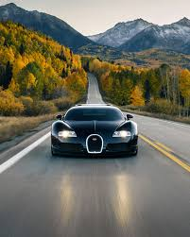
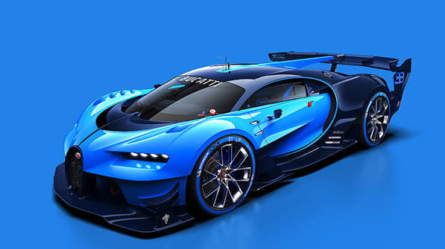

Slide 5
Today
Value Chain & Cost Analysis

Slide 6
A STORY TO START
A ₹50,000 Loan to World's Largest Bicycle Maker
1956, Ludhiana
Four Munjal brothers, having traded bicycle parts since the 1940s, take a bank loan of about ₹50,000 to start Cycles company.
The advantage nobody could see from outside
Rather than buying components from outside suppliers, they built deep in-house manufacturing capability for parts most rivals bought externally — tightening quality and cutting costs at every step.
By 1986
The company entered the Guinness Book of World Records as the world's largest bicycle manufacturer — built not on one clever idea, but on controlling its entire value chain.
History based on widely documented accounts of Hero Cycles (founded 1956, Ludhiana) and its 1986 Guinness World Record.
5 / 17

Slide 7
CORE CONCEPT 1
What Is a Value Chain?

Slide 8
CORE CONCEPT 1
What Is a Value Chain?
Every step a business takes to turn raw inputs into something a customer will pay for and each step either adds value or/and adds cost.
Why Hero Cycles cared about every link
Most bicycle makers bought parts and assembled them. Hero went further back in the chain making more components itself so it controlled quality and cost at more steps than its rivals could.
Concept based on: A. Nag, Strategic Management: Analysis, Implementation and Control, Ch. 7.
6 / 17

Slide 9
CORE CONCEPT 2
Primary Activities
Inbound Logistics
Operations
Outbound Logistics
Marketing & Sales
Aftersales

Slide 10
CORE CONCEPT 2
Primary Activities
Inbound Logistics
Getting raw materials in
Operations
Turning inputs into the product
Outbound Logistics
Getting the product to customers
Marketing & Sales
Convincing people to buy
Aftersales
Supporting the customer after the sale

Slide 11
CORE CONCEPT 3
Support Activities
Procurement
Technology Development
Human Resource Management
Infrastructure

Slide 12
CORE CONCEPT 3
Support Activities
Procurement
Buying what the business needs, well
Technology Development
Improving how things get done
Human Resource Management
Hiring, training, and keeping good people
Infrastructure
The systems that hold everything together
Support activities don’t deal with the product directly — but without them, the primary activities fall apart.

Slide 13
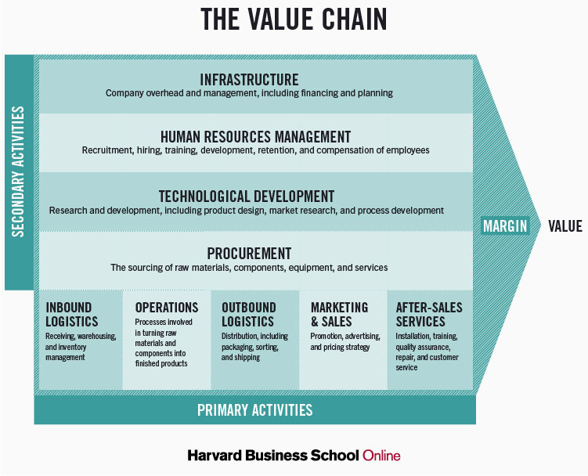
Value Chain

Slide 14
BACK TO BONCHO’S MOMOS
Mapping His Value Chain
Inbound
Buying vegetables and flour each morning
Operations
Prepping and steaming the momos
Outbound + Sales
Serving customers at the cart, and maybe, delivery

Slide 15
CORE CONCEPT 4
What Is Cost Analysis?
Figuring out exactly where money is spent across the value chain — and whether each step earns its cost back.
A step that costs a lot but adds little value to the customer is a target for cutting. A step that costs a little but creates a lot of value is worth protecting, even growing.
Hero's in-house component manufacturing lowered cost at a step most rivals treated as an expensive external purchase.
Based on: A. Nag, Strategic Management: Analysis, Implementation and Control, Ch. 5.
9 / 17

Slide 16
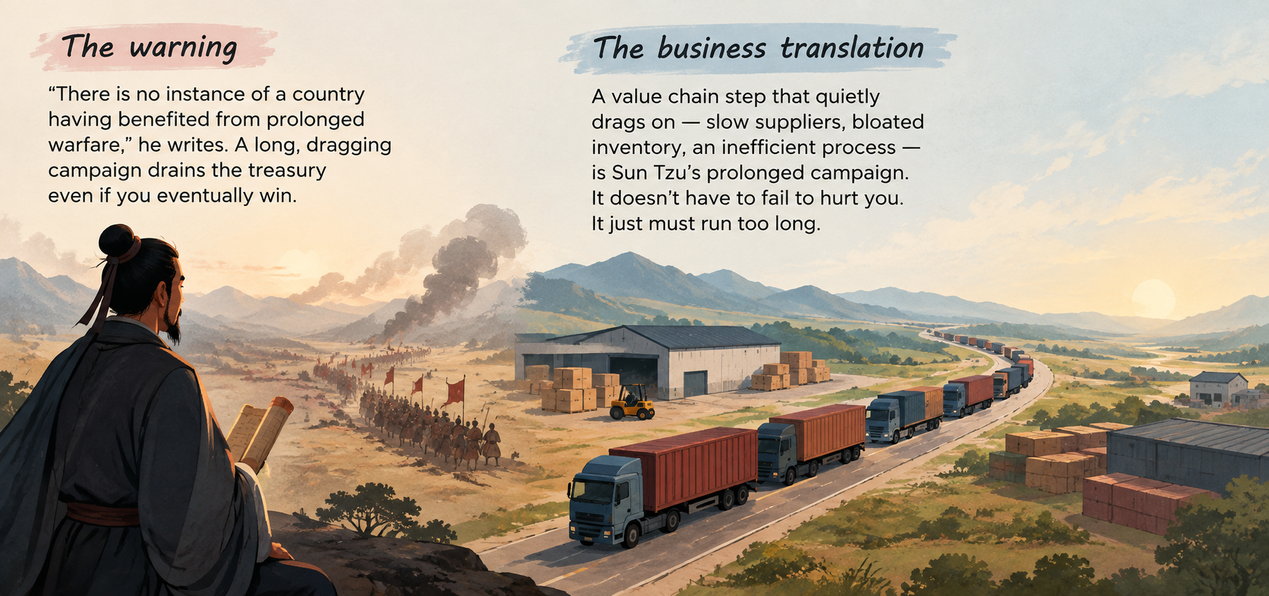
FROM THE READING: SUN TZU, CH. II
Sun Tzu's Economics of War

Slide 17
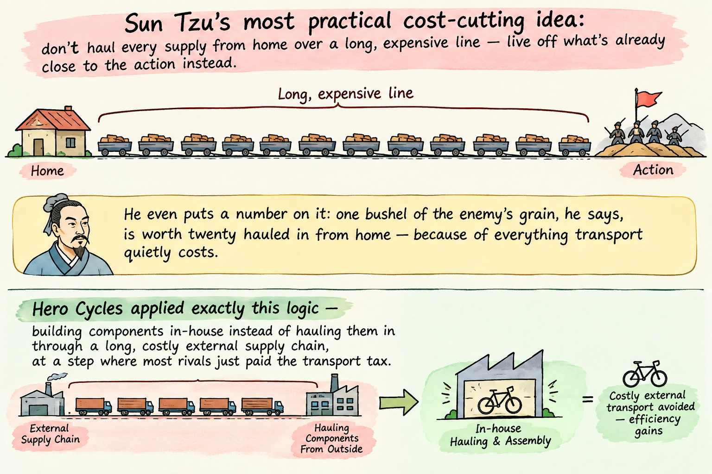
FROM THE READING: SUN TZU, CH. II
“Forage on the Enemy” — The Value Chain Lesson

Slide 18
CLASS ACTIVITY · 10 MINUTES
Find the Cost Advantage
Pick any business you know. Walk through its value chain
• Which step costs the most, honestly?
• Which step does the customer notice and value?
• Find one step where it could cut cost without losing customer value.
14 / 17

Slide 19
WHY THIS MATTERS
Why This Matters for a Founder
1
Most founders know their total costs but not where in the chain those costs sit
2
A value chain view shows exactly which step to fix first, instead of cutting costs everywhere at once
3
Hero's advantage wasn't a single genius idea — it was controlling one link in the chain better than anyone else
15 / 17

Slide 20
SUMMARY
Key Takeaways from Today
A value chain is every step that turns inputs into something customers will pay for
Primary activities touch the product directly; support activities hold everything up
Cost analysis finds where money is spent — and whether each step earns it back
Sun Tzu warned that a dragged-out campaign drains resources even without losing — the same is true of an inefficient value chain step
Hero Cycles built a world-record business by controlling one link in the chain better than rivals

Slide 21
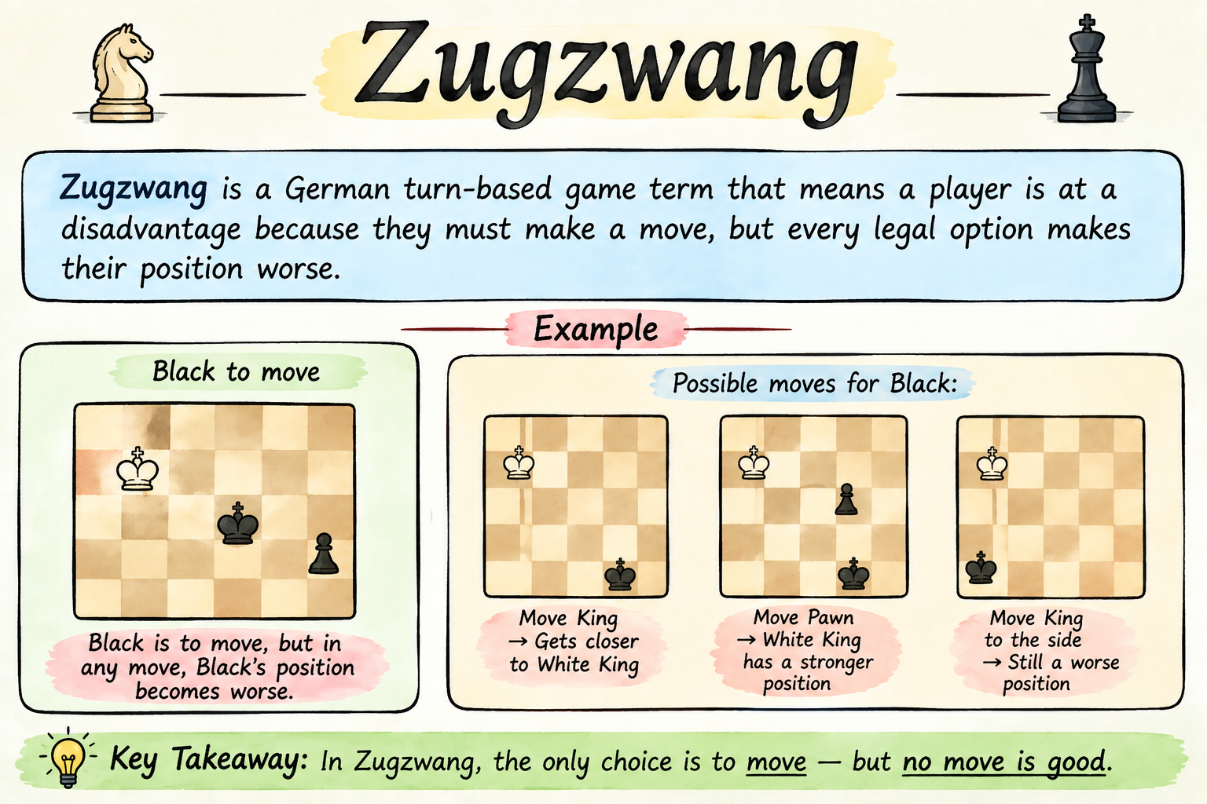
Term of the day
Zugzwang

Slide 22
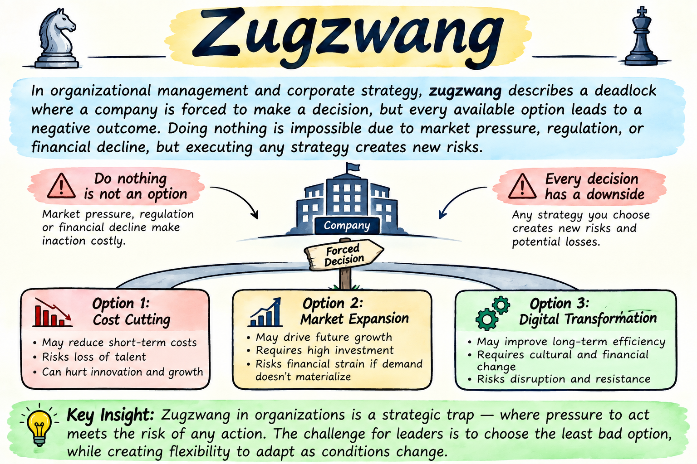
Term of the day
Zugzwang

Slide 23
Term of the day
Causes
Strategic Inertia: Ignoring market shifts (like Kodak ignoring digital photography) until only bad choices remain.
Over-Regulation: Compliance frameworks that trap a business between legal penalties and operational paralysis.
Sunk Cost Fallacy: Pouring resources into a failing project until it becomes too big to abandon safely, yet too broken to fix.

Slide 24
Term of the day
Cure
Introduce a Third Variable: If Option A and Option B are both fatal, pivot to a completely new market, product line, or business model.
Buy Time: Outsource the problem or form a strategic partnership to shift the risk and delay the forced decision.
Controlled Sacrifice: Accept that a loss is inevitable. Choose the option with the most predictable damage, take the hit early, and preserve resources to rebuild.

Slide 25
REFERENCES & NEXT SESSION
Sources & What's Coming Up
Required Reading
A. Nag — Strategic Management: Analysis, Implementation and Control, Ch. 5 & 7
Case & History Sources
Case: Hero Cycles (Value Chain)
Sun Tzu — The Art of War, Ch. II
Publicly documented history of Hero Cycles (founded 1956)
Term for Next Session— Pyrrhic Victory
17 / 17

